Slide 1
Well-Being Resources for Faculty & Staff
ECU Human Resources

Slide 2
Faculty & Staff Assistance Program
WHO: ComPsych & GuidanceResources provide services to all permanent employees and immediate family members in their households
WHAT: No cost, confidential solutions to life’s challenges
WHEN: Available 24/7
WHERE: 833-743-8183 or guidanceresources.com, WEBID: ECUFASAP
HOW: Your ComPsych ® GuidanceResources ® program offers someone to talk to and resources to consult whenever and wherever you need them.

Slide 3
Confidential Mental Health Support
Confidential Mental Health Support
The FASAP’s highly trained clinicians will listen to your concerns and help you or your family members with any issues, including:
Anxiety
Depression
Stress
Grief & loss
Relationship/marital conflicts
ECU Employees can receive up to three free counseling sessions with a licensed therapist per event
All programs are strictly confidential. Records are maintained by ComPsych®. Summary reports provided to ECU do NOT identify individuals

Slide 4
Work-Life Balance Solutions
Work-Life Solutions
ComPsych’s specialists can provide qualified referrals and practical information for just about anything on your to-do list, such as:
Finding child and elder care
Educational options
Community information
Hiring movers or home repair contractors
Event planning
Pet care
Assistance with shopping and locating items
Relocation and moving
All programs are strictly confidential. Records are maintained by ComPsych®. Summary reports provided to ECU do NOT identify individuals

Slide 5
Legal and Financial Services
Legal Guidance
Talk to one of ComPsych’s attorneys for practical assistance with your most pressing legal issues, including
Family law
Wills
Bankruptcy
Estate planning
Real estate
ID theft
Need representation? Get a free 30-minute consultation and a 25% reduction in fees
Financial Resources
ComPsych’s financial experts can provide confidential and objective guidance for a wide range of issues such as:
Retirement planning
Income and other taxes
Real estate and mortgages
Credit management and debt
Retirement planning
All programs are strictly confidential. Records are maintained by ComPsych®. Summary reports provided to ECU do NOT identify individuals

Slide 6
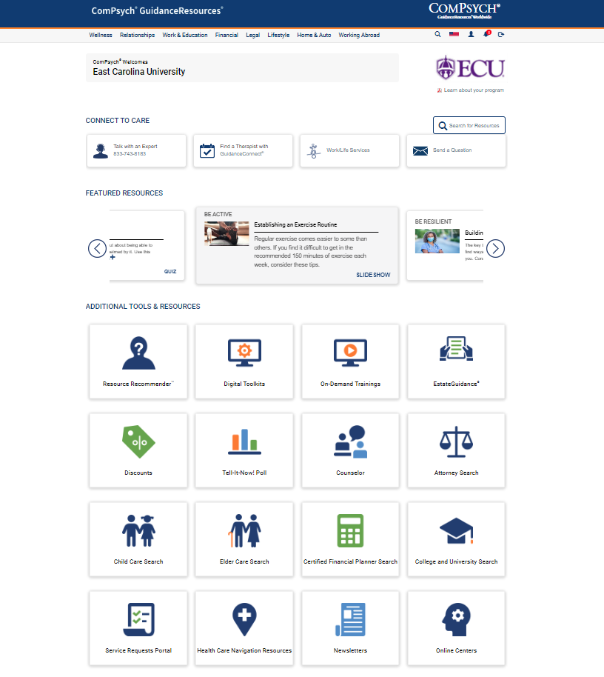
Online Services
Online Support
GuidanceResources ® Online is your 24/7 link to vital information, tools and support.
Use the webID: ECUFASAP to log on for:
Articles, podcasts, videos, slideshows
On-demand trainings
“Ask the Expert” personal responses to your questions
Click to chat with a Guidance Consultant
www.guidanceresources.com

Slide 7
Mental Health Support
ECU has partnered with Headspace to provide on-demand, confidential mental healthcare, day or night - 24/7/365. Chat via text with a trained behavioral health coach within seconds and meet with a licensed therapist or psychiatrist via video on weekends and evenings—all from the privacy of your smartphone.

Slide 8
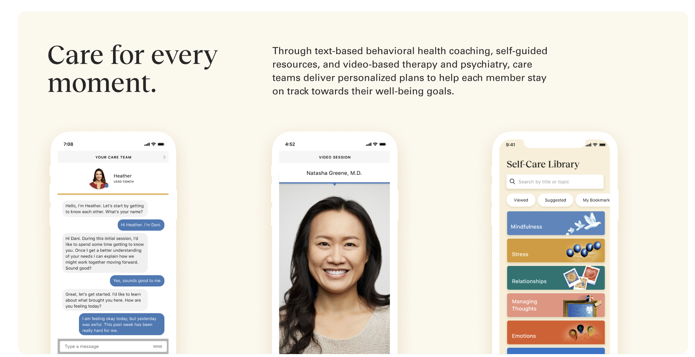
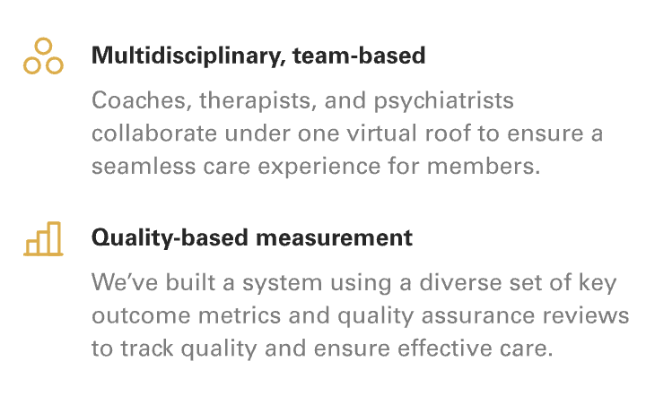
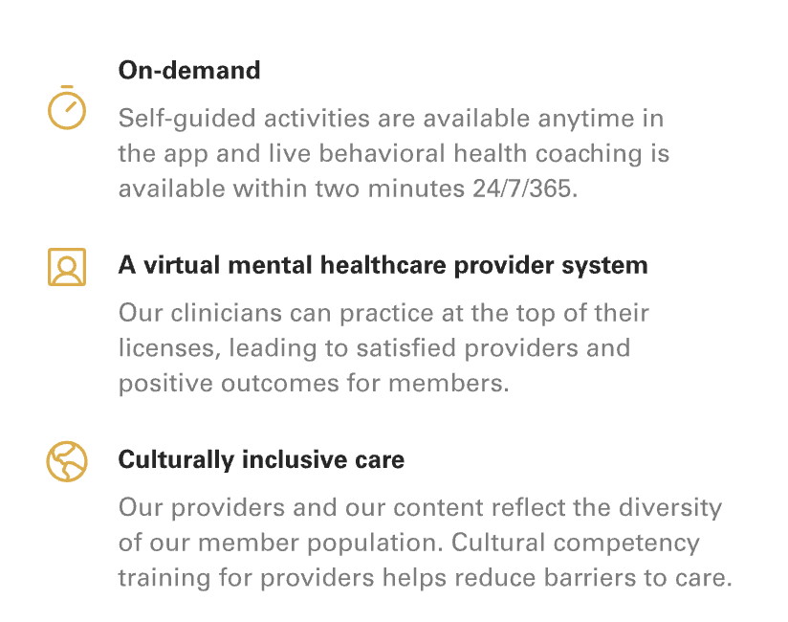
Human-to-human mental health support.
Behavioral Health Coaching
Live behavioral health coaching is available within two minutes for in-the-moment support or through scheduled sessions. Coaches help members learn strategies to manage life challenges and everyday stress
Therapy & Psychiatry
Members can schedule video appointments with a licensed clinician within a few days right through the app. Our diverse team of therapists and psychiatrists are trained to provide care for any member of any community.
Guided Self-Care
Our library of guide self-care resources, including activities, podcasts, and articles, is available anytime in the app, with personalized recommendations to help with sleep, relationships, career, and more.

Slide 10
Looking for more ways to improve your well-being?
Check out the learning opportunities in Cornerstone, including on-demand courses from experts on everything from time management to avoiding burnout to preparing for a big financial change. Check out Cornerstone through PiratePort!
If you have other questions about resources, check with your supervisor or contact hrdevelopment@ecu.edu for additional information!

